Slide 1
Exploratory Data Analysis: Unveiling Trends in Food Delivery
TEAM MEMBERS -
ADITHYA REDDY BOLLARAM
NIKHIL KATTAGURI
SATHVIKA SHETTI

Slide 2

Introduction & Problem Statement-
Our analysis will center on data related to food delivery, including order type, delivery time, delivery personnel details, and destination.
This project analyzes historical data to accurately forecast food delivery times, optimizing delivery processes and improving customer experiences.

Slide 3





METHODOLOGY :
DATA COLLECTION AND LOADING: Load Kaggle's online retail platform database into a Pandas data frame.
DATA EXPLORATION: Exploring the number of rows & columns, ranges of values etc.
DATA PREPARATION: Modifying column values, creating additional columns, dropping unnecessary ones, and updating data types.
DATA CLEANING: Preprocess the data which involves handling missing values, removing duplicates, and ensuring data consistency.
DATA VISUALIZATION: Visualizing data through charts and graphs to identify patterns, trends, and relationships.

Slide 4
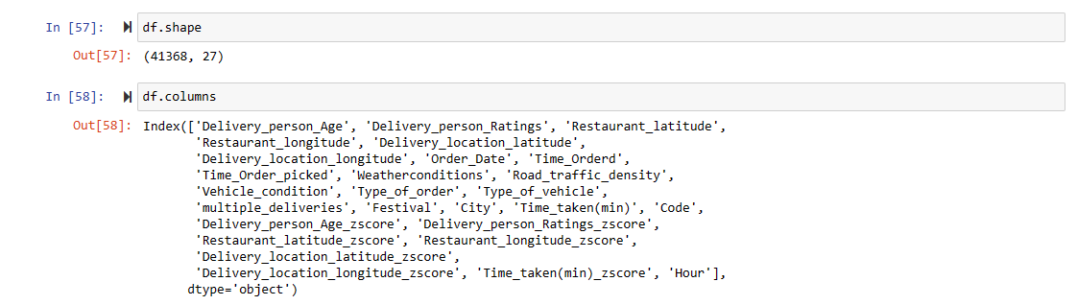
DATA EXPLORATION:
Our data has 41368 rows and 27 columns.

Slide 5
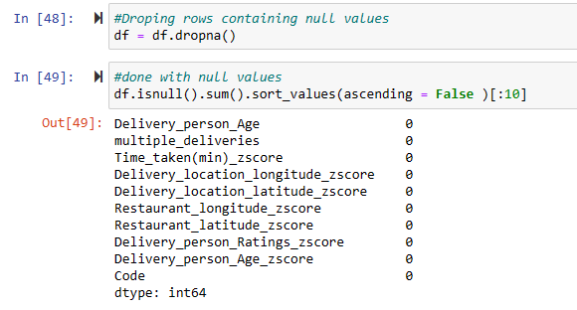
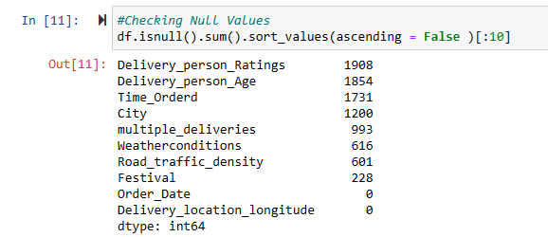

DATA CLEANING:
There are 8 columns which contains Missing values:
Removing Missing values ->
Checking for duplicate values:

Slide 6
DATA VISUALIZATION:
Can we build a predictive model to estimate delivery time based on a combination of weather conditions, road traffic density, and the type of vehicle used, while also considering the festival and city variables?

Slide 7
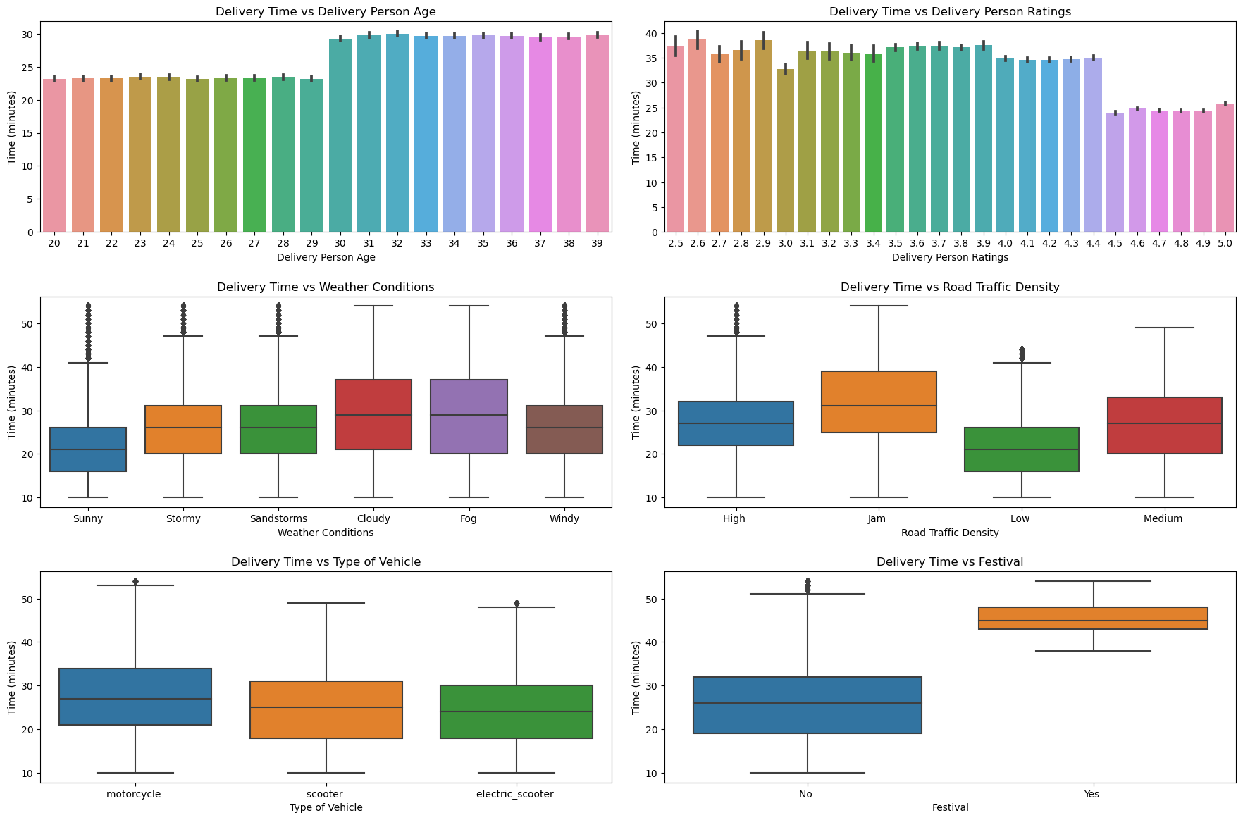

Slide 8
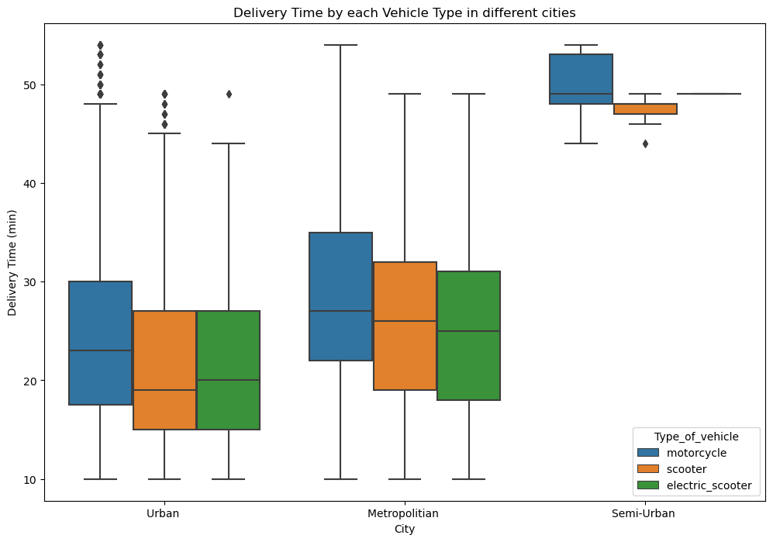
Delivery Time taken by each Vehicle Type in different cities

Slide 9
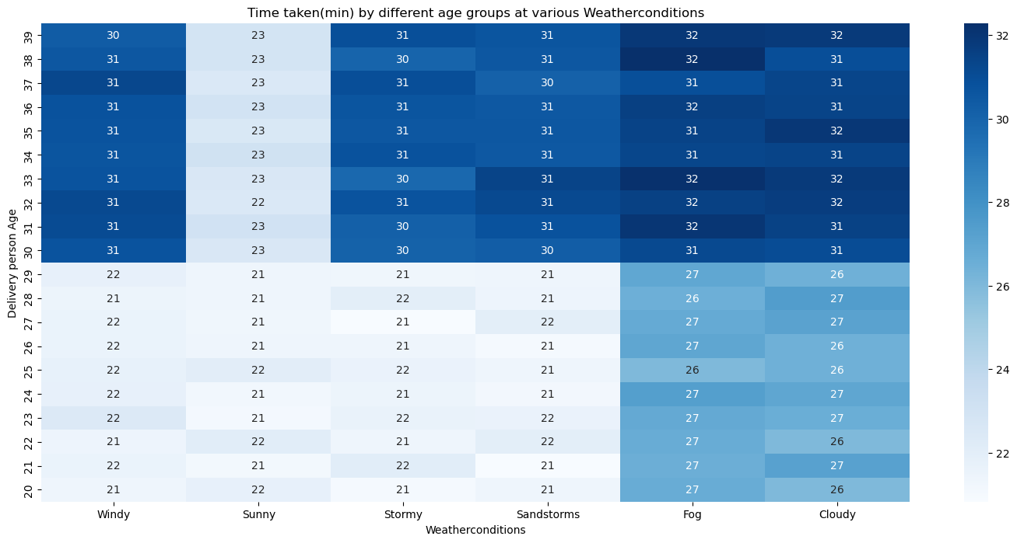
Summary of the time taken (in minutes) by different age groups under various weather conditions..

Slide 10
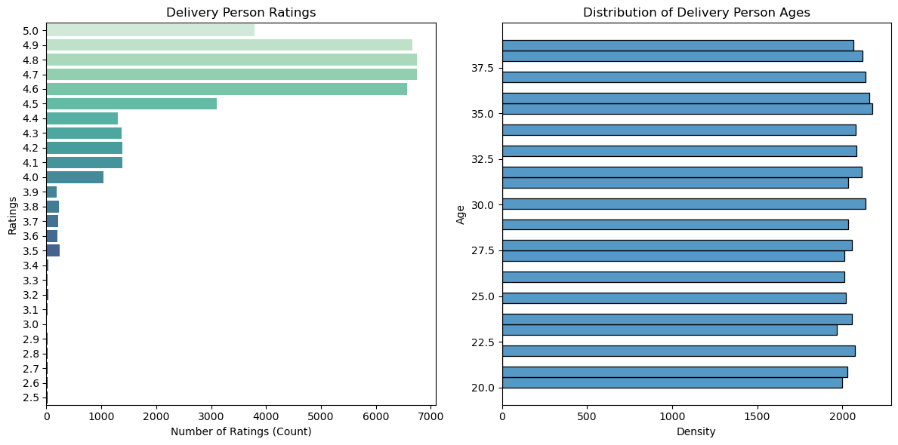
How delivery person ratings and age distribution are related?

Slide 11
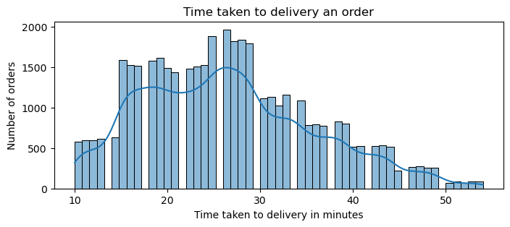
Time taken to delivery an order

Slide 12
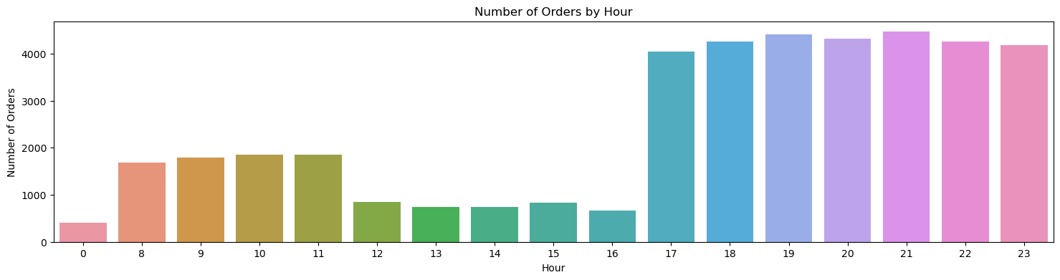
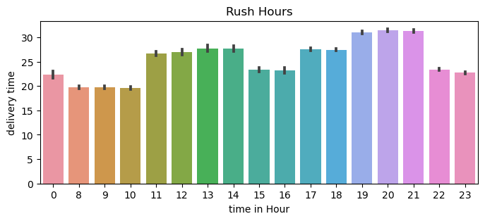
In which hour in a day there are more number of orders placed?
Time taken to delivery in overall cities in specific hours

Slide 13
CONCLUSION :
The analysis has provided a better understanding of the delivery time patterns and trends. This information can be utilized to estimate the time required for future deliveries, taking into consideration various factors like the age and ratings of the delivery person, the distance between the restaurant and the delivery location, the time of the order, weather conditions, road traffic density, vehicle condition, and the city.
FUTURE SCOPE :
In the future, we plan to improve this project by integrating real-time data on traffic and weather. We also aim to explore emerging technologies such as AI route optimization and drone deliveries. To make the model more accurate and applicable, we will expand the study to include more diverse geographic data. These advancements could significantly enhance our predictive capabilities and ensure that delivery services remain innovative and customer focused.

Slide 14


